Slide 1
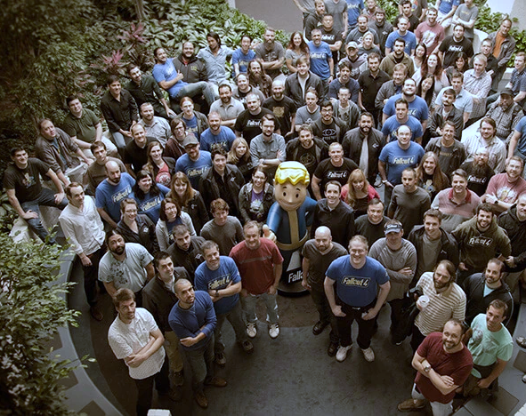
BSc Hons Computer Games Design and Development GDV4000 Introduction to Games Industry Practice
An Overview of the Interactive Entertainment Industry
(aka. The Video Games Industry)
The Fallout 4 Dev Team – Bethesda Softworks

Slide 2

What we’ll be covering -
By the Numbers – Trends in the Games Industry
A Brief History of the Games Industry Part 1
Developer / Publisher Relationships
Traditional developer-publisher relationships
Indie Development
Funding
Marketing
Marketing avenues
Production planning around Marketing
Game life-cycle
Analytics
IP, Social, and Ethical Issues Part 1 – Intellectual Property

Slide 3


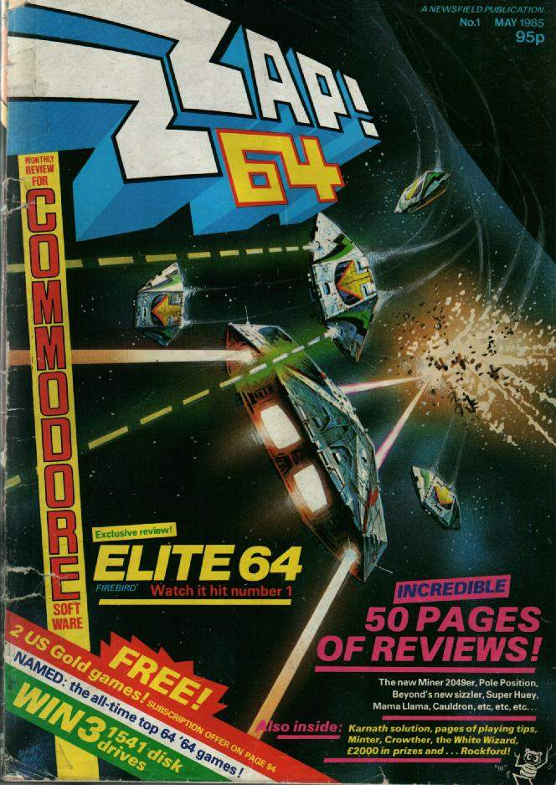

4. Marketing
How do you find out about games that are in development?
Marketing is a necessary, and often frowned upon, part of the product life-cycle. Marketers are adept at their job.
Traditionally, games were marketed through print media – industry / home computer magazines. Media coverage, such as favourable reviews were also beneficial.
Larger publishers could also leverage broadcast media. https://youtu.be/dTJ1Xf_EItA?si=cQieQ8r5o_a-C690
© Copyright Future PLC
© Copyright Newsfield Publications

Slide 4
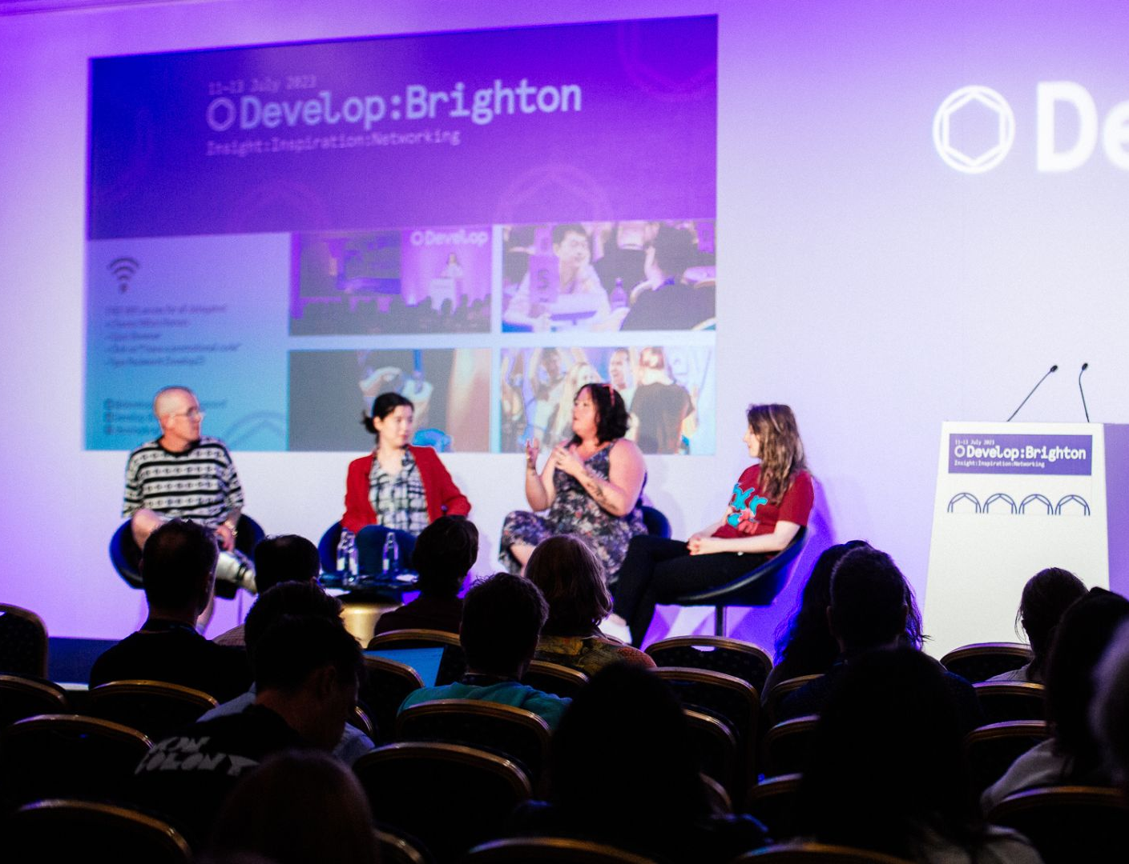
4. Marketing
Alongside printed and broadcast media, gaming conventions are an important part of the marketing process.
Some important shows:
UK Games Expo (UK)
EGX (UK)
GamesCom (Germany)
Develop (UK)
IndieCade (US)

Slide 5




4. Marketing
Social Media can be a very powerful and effective marketing tool, particularly for solo and small dev teams. They can utilise social media to communicate directly with their potential audience, and to keep the community updated.
The rise of streaming games to an audience, through platforms such as Twitch and YouTube, has created some unique opportunities for marketing games.
Twitch/YouTuber ‘InSym’ has introduced his audience to many indie ghost-hunting horror games, such as Phasmophobia, Demonologist, Forewarned…

Slide 6
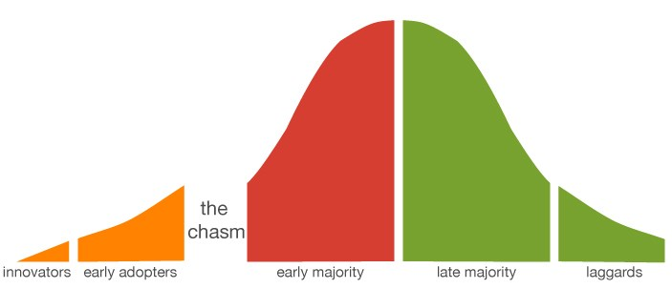
4. Marketing
To market a modern game, it is important to understand two important aspects:
The timing of updates and feature releases to maximise the product’s life-cycle
Analytics to better understand your players and how they engage with the game
• Geoffrey Moore’s “chasm” represents the challenge start-ups must face when migrating a product to the masses. To overcome this…
Typical product life-cycle…
Early access, limited time trials
Create the “whole product” – don’t try to sell to the majority without being feature complete.
2. Market the product appropriately for “sceptical pragmatists” who make up the early majority
3. Price the product relative to competitive comparisons rather than using value-based pricing (value as perceived by the customer)
4. Distribute the product through the right channels
http://www.theinnovativemanager.com

Slide 7
4. Marketing
For games, particularly mobile, the shelf-life can be very short.
In order to maximise investment, understanding where the game is in the product life-cycle is important as it allows the timing of new features / updates to re-generate interest in the game, increasing its shelf-life.
http://www.theinnovativemanager.com

Slide 8

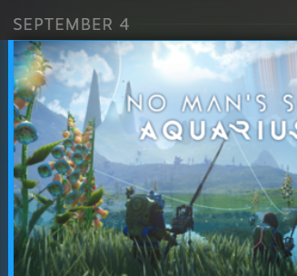
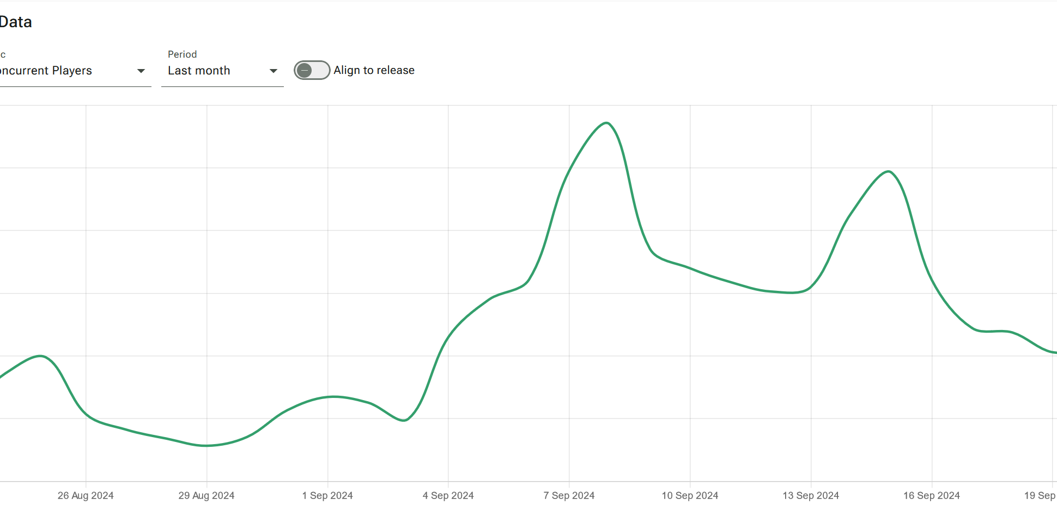
4. Marketing
We can see this in action with games such as No Man’s Sky by Hello Games.
No Man’s Sky has been supported since its release with free updates and DLC.
The updates can cause an upswing in sales and also lure lapsed players back to the game.
No Man’s Sky utilises Expeditions, which are time-limited events where players can earn new items and cosmetics for completing a series of quests.
These Expeditions also are streamed on Twitch for rewards.
Source: https://vginsights.com/game/no-man-s-sky

Slide 9
4. Marketing
Analytics are important as they can guide game design. For mobile and F2P games, understanding your player-base is crucial for monetisation and generating revenue.
Three primary areas of data collection are:
The User (Player / Customer): How does the player interact with the game (where do they go? What do they do?), their performance, interactions with other users.
Performance: Technical information relating to the game’s performance, such as FPS, server load, latency, hardware considerations such as GPU)
Process: For the publisher and developer – Monitoring task size / allocation, sprints (depending on the methodology employed)

Slide 10
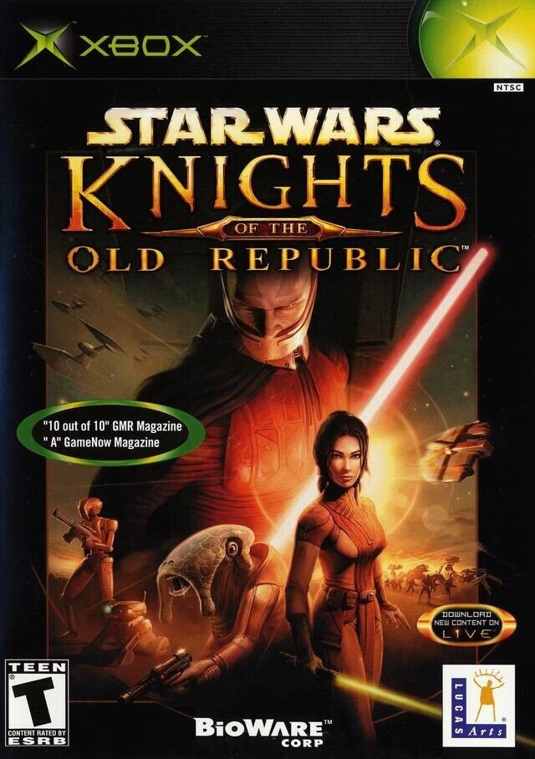


5. IP, Social, and Ethical Issues 1
Intellectual Property (IP)
IP is crucial (as we saw earlier with what happened with Pong), given how much value we place on brands. IPs such as Star Wars, Halo, and James Bond, have been used to attract customers to buy particular consoles.
When something new is generated (stories, characters…) that is new IP.
Your intellectual property can be protected in a few different ways:
Copyright: From the moment someone creates a piece of work, they retain the copyright until, under UK law, 70 years after the year of their death.
Patents: A patent enables the author to publish their ‘invention’ in return for a state-granted monopoly on it. Others wishing to implement the invention require a licence / permission. The patent holder reserves the right to restrict use and development of the invention.
Mathematical concepts cannot be patented (they are discovered rather than invented), but in certain regions, such as the US, software can! This has led to a fundamentally broken system, with low-quality patents being registered, and ‘Patent Trolls’ hoarding patents in order to extract licence fees from unwitting users of their IP, without ever producing any products of their own.

Slide 11
5. IP, Social, and Ethical Issues 1
Intellectual Property (IP)
Patents continued…
Patents can be expensive, and also as a legal document difficult for a layperson to follow.
It can be even more expensive to defend a patent! Consider the issues currently underway with Nintendo and Pocketpair, the makers of Palworld. Nintendo are currently pursuing legal action and filing a lawsuit for patent infringement rather than copyright infringement (Yin-Poole, 2024).
Most large companies cross-licence patents, but smaller companies cannot do this, but this is offset by how costly it would be for a larger company to chase up a smaller one, given that it would cost more to sue them than they would likely receive in return.

Slide 12
5. IP, Social, and Ethical Issues 1
Intellectual Property (IP)
Trademarks – A trademark is a label or logo that is used to identify your brand/ IP in the marketplace. There are two types…
®(Registered Trademark) – A company can register their trademark within a region to state formally that the IP is their key brand or identifier.
™(Trademark) – The company is stating a claim to the mark but has not registered it. Despite it not being registered, the company can still argue that it is their brand in the marketplace.
Example – Unity has a set of guidelines for how and where their logo may be used, including the colour scheme and whether it can be animated.

Slide 13
5. IP, Social, and Ethical Issues 1
Intellectual Property (IP)
Trade Secrets – Mainly for technical innovations but can extend to content and future projects. It is common in the industry for developers to sign Non-Disclosure Agreements (NDAs), that limit or prohibit what they can discuss about the project outside of the studio. This is done to prevent leaks or expose proprietary hardware (such as Dev Kits) to other interested parties who could steal the ideas.
Epic took one of its Fortnite QA testers to court for breach of an NDA in 2019 when they leaked information regarding Fortnite Chapter 2. Epic had spent time seeding clues and Easter eggs, and they claimed that the leaks ruined the surprises they had planned (Carpenter, 2019).

Slide 14
References
Britannica, (2024) Pong: electronic game. [Online] Available at: https://www.britannica.com/topic/Pong [Accessed 21 September 2024]
Carpenter, N. (2019) Epic Games suing Fortnite tester who leaked Chapter 2 [Online] Available at: https://www.polygon.com/fortnite/2019/10/25/20932658/epic-games-fortnite-lawsuit-chapter-2-leak [Accessed 22 September 2024]
Clement, J. (2024) Consumer spending on boxed software video games in the United Kingdom (UK) from 2013 to 2023 [Online]. Available at: https://www.statista.com/statistics/513292/consumer-spending-on-boxed-software-united-kingdom-uk/ [Accessed 21 September 2024]
Dalakov, G (N.D.) Goldsmith and Mann [Online]. Available at: http://www.computer-timeline.com/timeline/goldsmith-and-mann/ [Accessed 21 September 2024]
McEvoy, S. (2024) TIGA: UK games studios “cautiously optimistic” about the industry in 2024 [Online]. Available at: https://www.gamesindustry.biz/tiga-uk-games-studios-cautiously-optimistic-about-the-industry-in-2024 [Accessed 18th September 2024]
Stilphen, S. (N.D.) The Atari Compendium: The Great Market Crash [Online] Available at: https://www.ataricompendium.com/archives/articles/crash/crash.html [Accessed 18th September 2024]
Ukie (2024) 2023 Video Game Industry Valuation [Online]. Available at: https://ukie.org.uk/news/2024/04/2023VideoGameIndustryValuation [Accessed 18th September 2024]
Wardrip-Fruin, N. (2021) Before Pong, There Was Computer Space [Online]. Available at: https://thereader.mitpress.mit.edu/before-pong-there-was-computer-space/ [Accessed 21 September 2024]
Yin-Poole, W. (2024) Palworld Developer Pocketpair Responds to Nintendo Pokémon Lawsuit, Says It’s Unaware of the Patents It’s Accused of Infringing [Online]. Available at: https://www.ign.com/articles/palworld-developer-pocketpair-responds-to-nintendo-pokmon-lawsuit-says-its-unaware-of-the-patents-its-accused-of-infringing [Accessed 22 September 2024]

